Slide 1
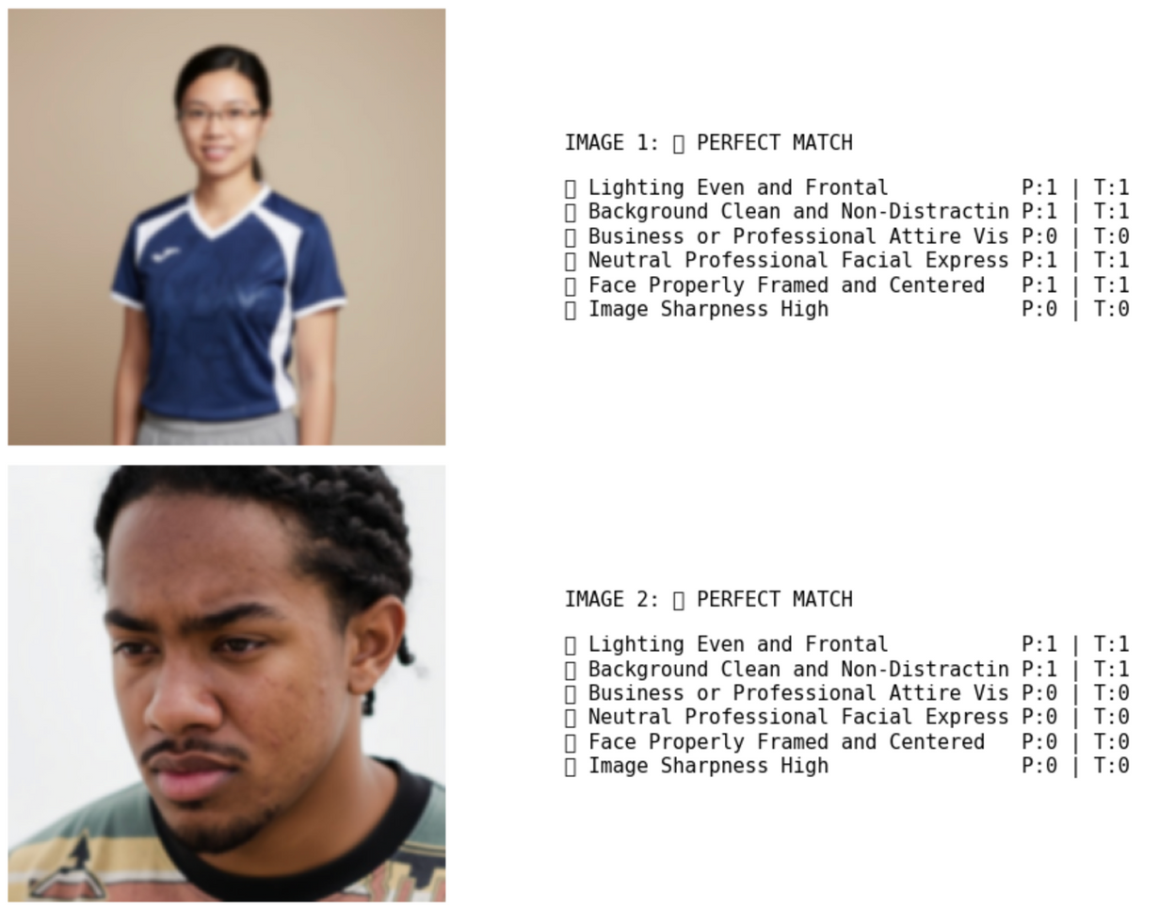
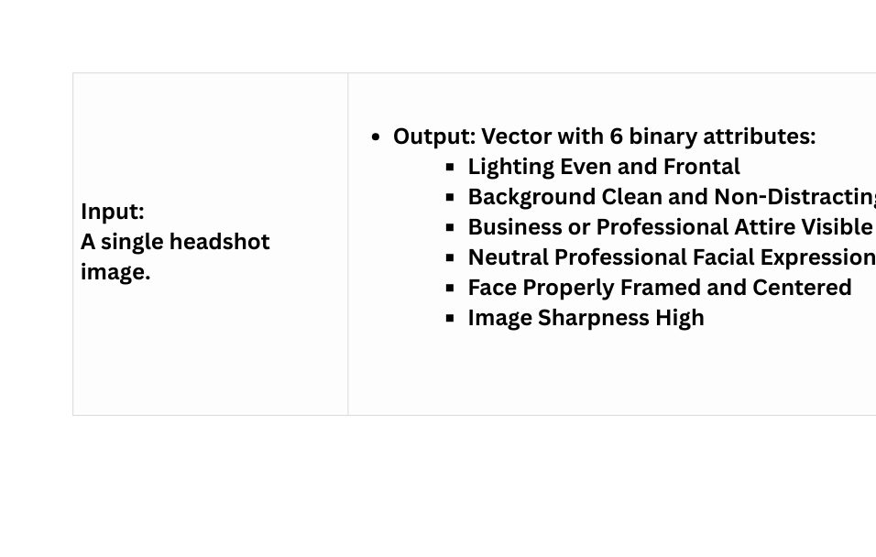
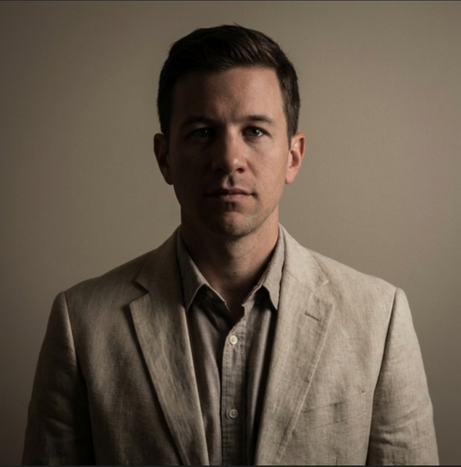
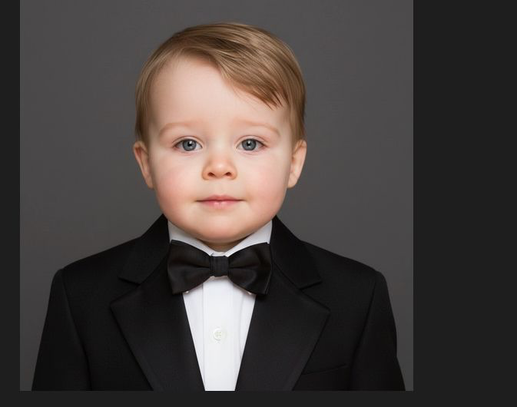
Professional Portrait Scoring
Project Specifications
What Changed from the Proposal
During analysis, we identified clearer key attributes that describe professionalism.
Switched from the proposed ResNet50/Standard ViT to a Swin Transformer.

Slide 2
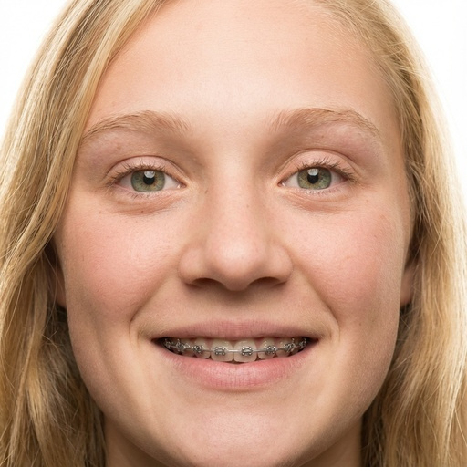
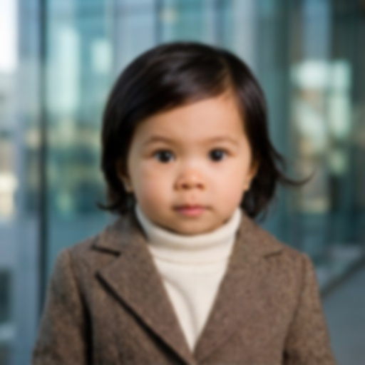
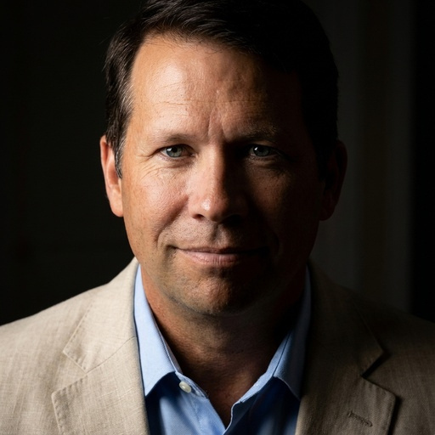
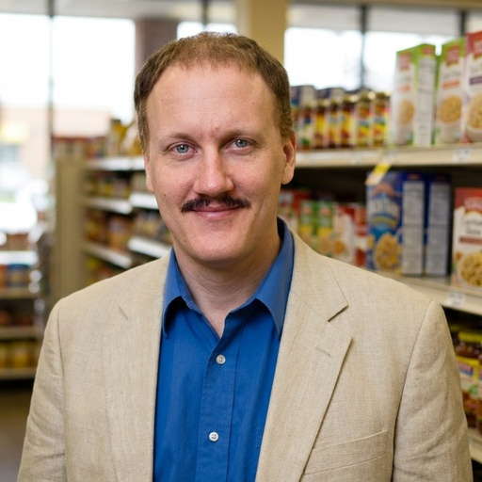
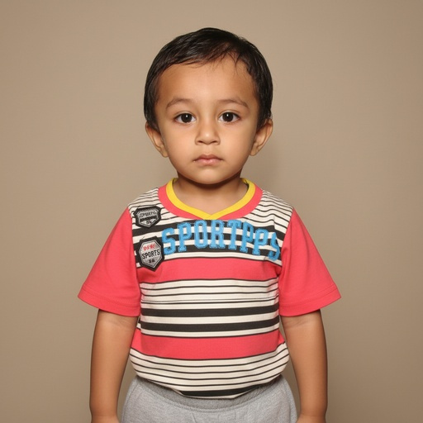
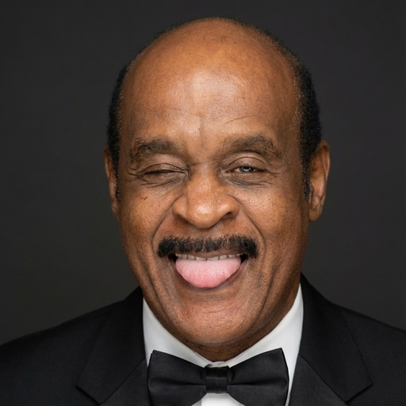
Bad Framing
Blurred
Bad Lightning
Bad Background
Bad Attire
Bad Expression

Slide 3
Related Literature
Paper | Focus | Key Idea | Relation to Our Project
Deep Learning-Based Image Aesthetic Quality Assessment – Review (2025) | General image aesthetics | Image quality depends on interpretable factors such as lighting and composition | Supports breaking professionalism into visual attributes
Face Image Quality Assessment: A Literature Survey (2022) | Face / portrait quality | Face Image Quality Assessment depends on pose, illumination, and sharpness | Grounds our focus on face-centric quality attributes such as pose, facial illumination, and sharpness, which are central to professional headshots.
Transformer for Image Quality Assessment (2021) | Image quality prediction | Transformers capture global image structure effectively | Motivates using Transformer-based architectures (like Swin) over CNNs

Slide 4
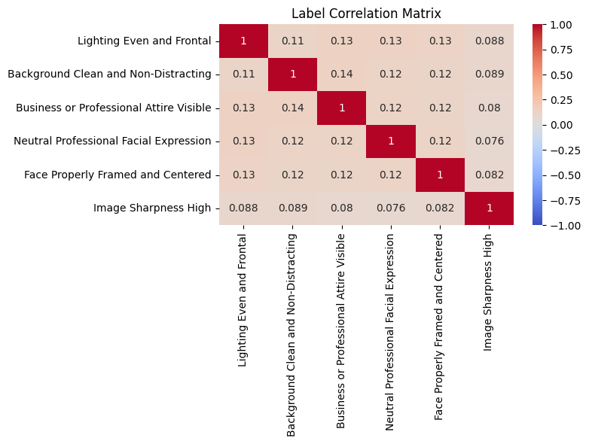
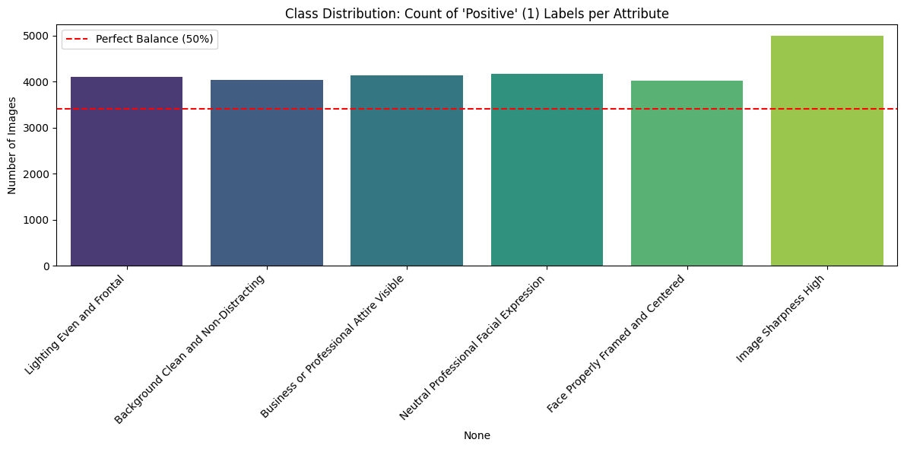
Dataset (FFHQ origin)
Dataset: Created 6,829 synthetic professional portraits using Gemini 2.5 Flash (Image-to-Image).
Technique: Generative Labeling (Labels Prompt). We first sampled random label vectors, then mapped them to dynamic prompts.
Sample Definition: Each sample consists of a 512×512 RGB portrait image paired with a 6-dimensional binary attribute vector and metadata (JSON).
EDA
Class Distribution: Positive-skewed (~60%) Most labels are 1, not 0.
Prompt Length: Average 40-60 words per input.

Slide 5
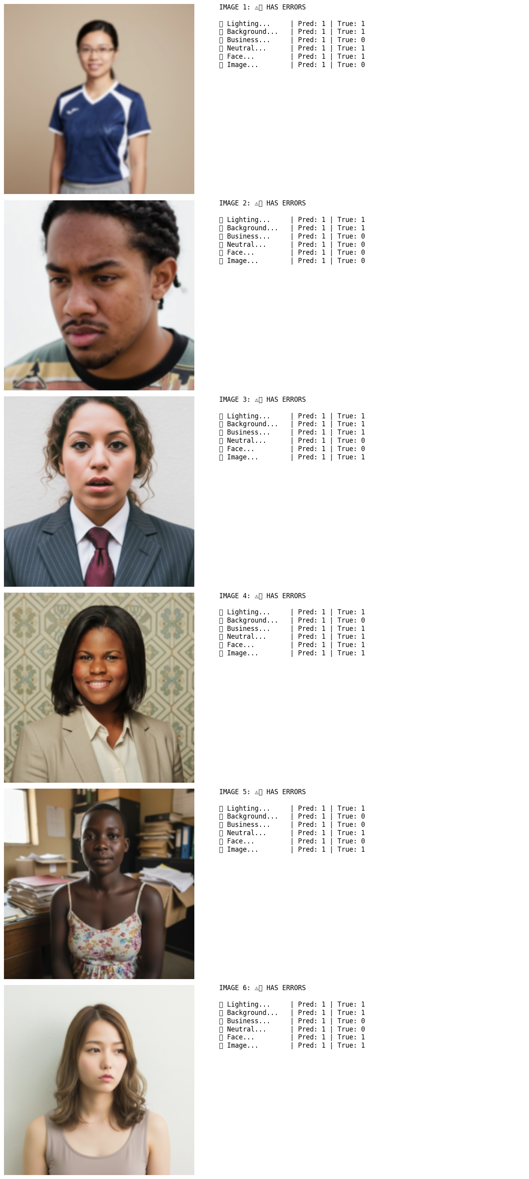
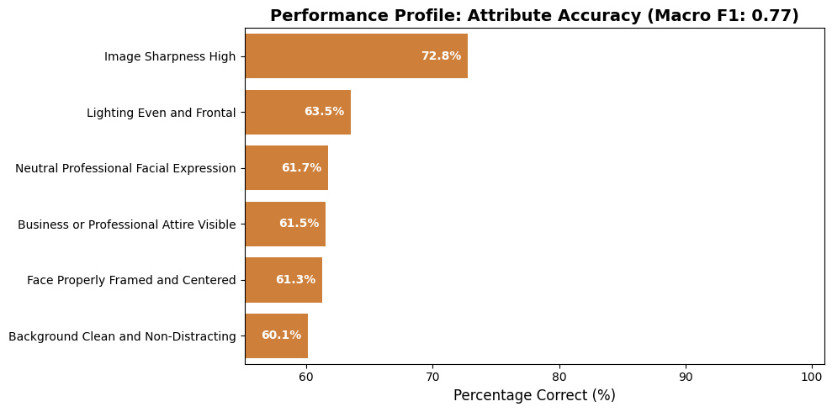
Model:Microsoft Swin Transformer (swin_tiny_patch4_window7_224), pretrained on ImageNet.
Training: Fine-tuned for 10 epochs.
Exact Match Ratio (all 6 attributes correct): 15.67%

Slide 6
Did you achieve the desired results?
What did we learn?
Partially.
The model predicts individual attributes reasonably well, but often fails to get all attributes correct together (Exact Match ≈ 15%)
The model performs better on single attributes than on joint predictions.
Some attributes (e.g., framing, expression) are visually ambiguous.
What should be different?
Future ideas
Change the training settings for optimization
See what the model looks at: Use attention maps to understand mistakes.
Compare models: Test other models to see if this one is really better.
Make another batch of syntatic data, with optimized prompts.
Focus on the face, based on the research presented
Some labels are unclear: Things like face framing are not really Yes or No. Measuring position would work better.
Less sharpness examples.
Better promoting, lightning prompts are not good enough

